Slide 1
The IT industry
in Cambodia
CHAPTER 2 : EXPLORE THE IT INDUSTRY

Slide 2

OBJECTIVES FOR THIS SESSION
Evaluate your understanding of the previous session
Improve your online searching skills
Explore the different IT sectors
Explore usage of IT sectors in daily life

Slide 3



What are the tips to do an online research?
ENGAGE
10 MIN

Slide 4






EXPLAIN
Tips to do online research
10 MIN
Define your research question
Use Keywords
Check the quality of your sources
Take notes
Cite your sources

Slide 5
Define your research question
ACTIVITY 1
15 MIN
What I want to know about this topic
What I already know about it
IT sector in Cambodia
What I still need to know
TO COMPLETE THIS ACTIVITY :
1
TEAM WORK
2
CLASS PRESENTATION
(10 min)
(5 min)

Slide 6
Use Keywords
ACTIVITY 2
15 MIN
Keywords are the words you will enter into Google to find information related to your research question.
Example: “I want to know how far are Phnom Penh and Battambang”
-> “Distance Phnom Penh Battambang
IT sector in Cambodia
In team, find as many keywords as possible!
TO COMPLETE THIS ACTIVITY :
1
TEAM WORK
2
RESULTS
(10 min)
(5 min)

Slide 7


Check your sources quality
EXPLAIN
10 MIN
Criteria
Relevance
Author
Objectivity
Accuracy
Completeness
Tips
Look for the author's credentials
Check the date
Read the source critically
Compare multiple sources

Slide 8

Source Evaluation Gallery walk
ACTIVITY 3
30 MIN
We have launched a online research on the topic “what if the future of the IT industry in Cambodia”.
The results of the search are those 6 sources, some are books, reports, article or personal blog.
In teams, analyze those sources and select the best one.
TO COMPLETE THIS ACTIVITY :
1
TEAM WORK
2
RESULTS
(20 min)
(10 min)

Slide 9
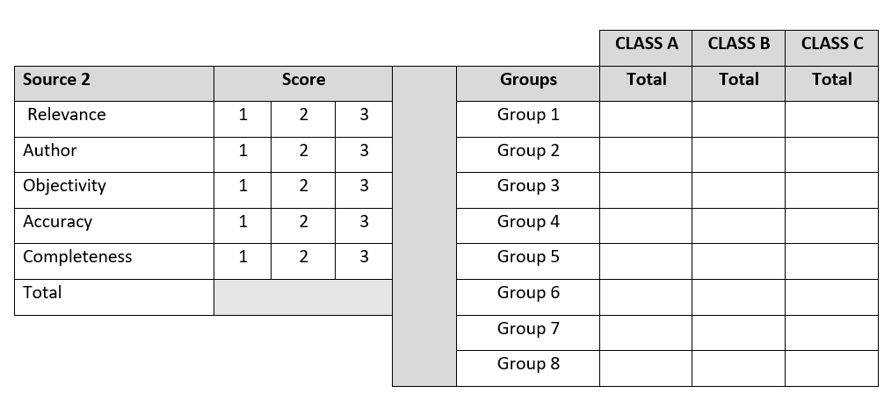
How to use the grid
ACTIVITY 3

Slide 10
HOMEWORK
Explore the IT sectors in Cambodia
You join a Career Forum at a high school. You are now IT experts. The high school wants you to present the most important IT sectors to the students.
Objective: the students should have a general understanding of this sector (What is it about? Why is it important? How do we use it in our daily life?)
In a team of 5, choose one of the following sectors, do online research and prepare slides. Each sector has 3 minutes to present.
IT sectors:
Software development Design and user experience
Quality assurance Customer support
Emerging technologies (IoT and Robotic)

Slide 11

GAME
What do you remember from
previous sessions?
15 MIN
Notes:
https://quizizz.com/admin/quiz/64b73985edee83001d8e191c?source=quiz_share

Slide 12

New IT vocabulary
EXPLAIN
10 MIN
Which words have you learned?
Are all the definitions clear enough?

Slide 13

Find practical examples
ACTIVITY 4
30 MIN
Now that you have a clear understanding of the IT sector, look for 1 or 2 examples in Cambodia. Add them to your presentation!
Your examples should be related to those domains:
Education Environment
Business Agriculture
Example: EcoMapper is an example of a software platform developed by the Cambodian Development Resource Institute (CDRI) and used by the Ministry of Environment. Combined with a marine vehicle the software collects data that users can visualize and analyze. Ex: quality of water and currents

Slide 14

ACTIVITY 5
Present the IT sectors in Cambodia
30 MIN
It is the day of the Career Forum! Each team will present an IT sector during 4 minutes.
After the presentation, feel free to ask questions !

Slide 15
Which sector will you choose? Why?
HOMEWORK
Choose one of the 5 sectors and explain why you want to choose that sector (minimum 5 reasons).

